Slide 1
ZEN Definition per January 2018 KEEP INTERNAL
01.02.2018 Inger Andresen, NTNU

Slide 2
What is a neigbhourhood?
In the ZEN research centre, a neighbourhood is defined as a group of interconnected buildings (new, retrofitted, or a combination of both),
energy and infrastructure (e.g. water, sewage, roads, communication and data lines) located within a confined geographical area and with a defined physical boundary to the electric and thermal grids.
The energy boundary is not necessarily the same as the geographical area for buildings and infrastructure.

Slide 3
System boundaries
New buildings
New infrastructure
Existing buildings that will not be upgraded
Existing infrastructure that will not be upgraded
Existing buildings that will be demolished
Existing infrastructure that will be demolished
Existing buildings that will be upgraded
Existing infrastructure that will be upgraded

Slide 4


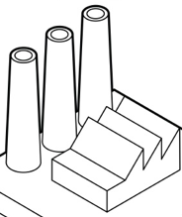
System boundaries
mobility
electricity
Energy, water, sewage, roads, communication and data lines
thermal

Slide 5
Goal: A zero emission neighbourhood aims to reduce its greenhouse gas (GHG) emissions towards zero within its life cycle.
A
B
C
D
E
F
G

Slide 6


A
Notes:
Energy efficient and renewables

Slide 7
A
The zero emission neighbourhood aims to become highly energy efficient and smartly powered by local renewable energy sources.

Slide 8


B
Notes:
Flexible energy flows + smart grid (responding to signals in the smart grid taken out in the latest version)

Slide 9
B
Manage energy flows in the built environment and with the surrounding energy system in a flexible way to facilitate the transition towards a decarbonised energy system.

Slide 10
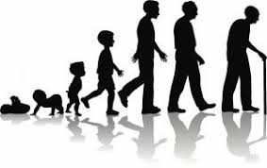

C

Slide 11
C
Design and construct buildings, infrastructure, components and materials in the neighbourhood to consider zero or low GHG emissions from the whole life cycle;
from extraction of raw materials, production, transport, installation, use, maintenance, repair, replacement, deconstruction, waste treatment, reuse, recovery and final disposal.

Slide 12

D

Slide 13
D
Plan, design and operate with respect to economic sustainability, and with a focus on minimising life cycle costs.

Slide 14

E

Slide 15
E
Achieve sustainable transport patterns through the overall design of the neighbourhood and implementation of sustainable smart mobility systems both locally and regionally.

Slide 16
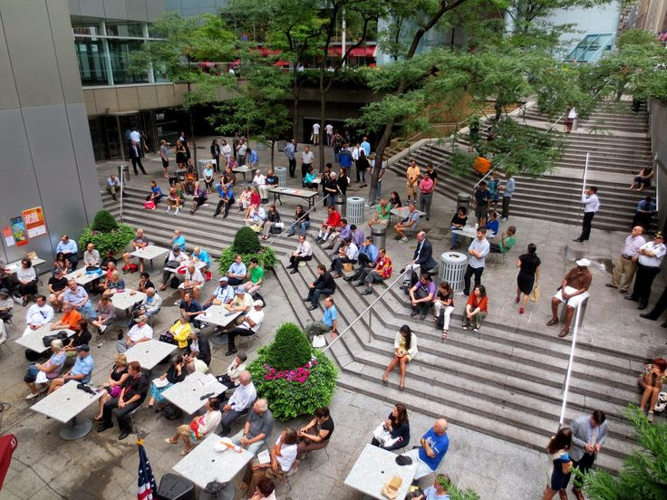
F

Slide 17
F
Plan and localise amenities in the neighbourhood to produce good spatial qualities that consider reduction of emissions also through their relationship with the larger region and promote sustainable behaviour.
Sustainable behaviour includes behaviour that results in reduced waste and resource use with a view to stimulate a circular economy.

Slide 18

G
Notes:
Innovation and sustainable behaviour

Slide 19
G
Development of the area is characterised by innovative processes based on new forms of cooperation between the involved partners leading to innovative solutions..

Slide 20
ZEN definition categories
Power
Energy
Emissions
Innovation
Economy
Spatial qualities
Mobility
Notes:
The relative importance of each category is defined in the different case/pilot

Slide 21
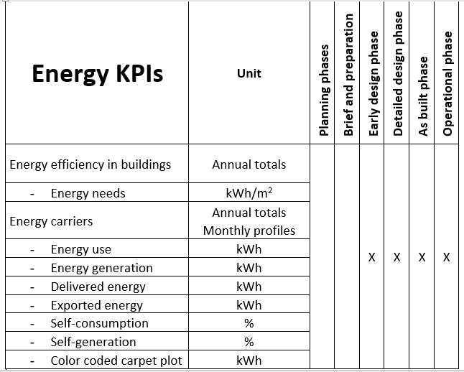

Slide 22
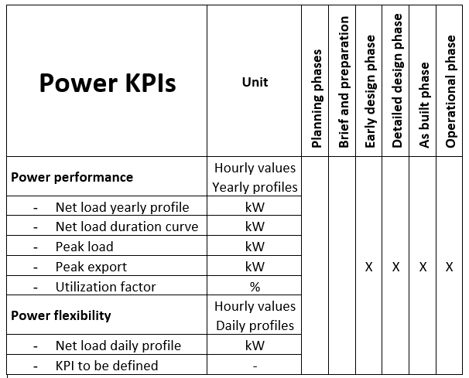

Slide 23
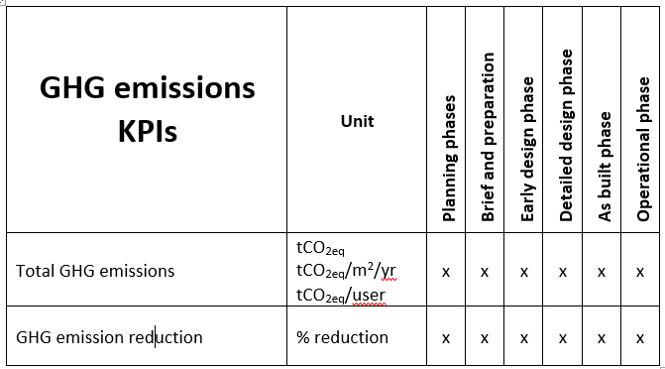

Slide 24
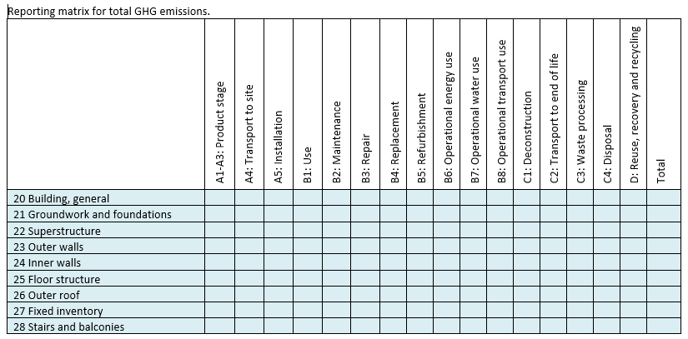

Slide 25
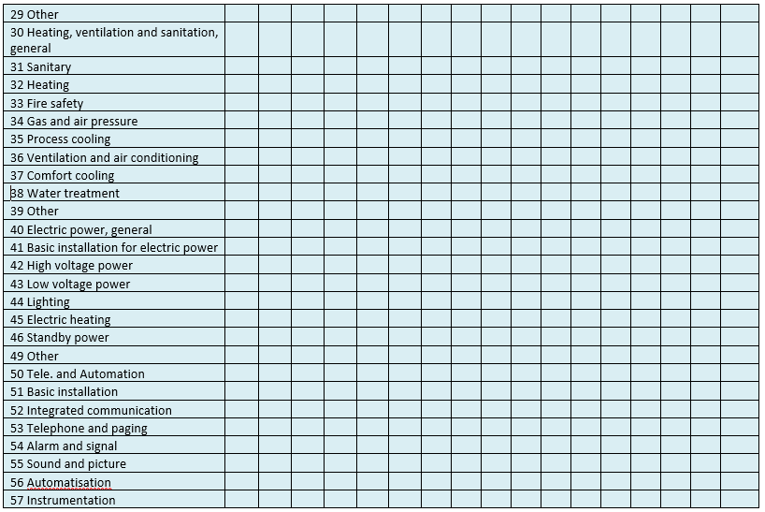

Slide 26
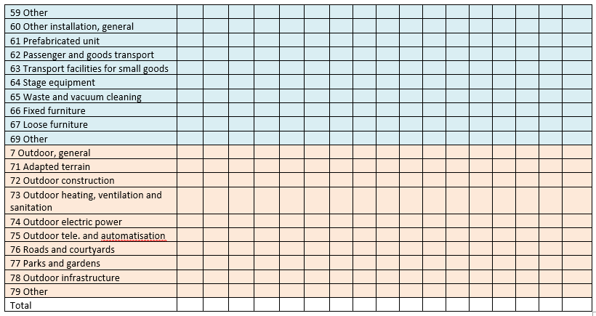

Slide 27
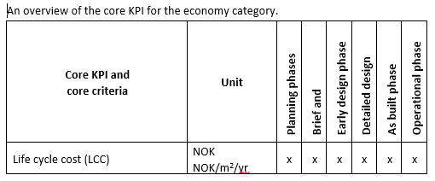

Slide 28
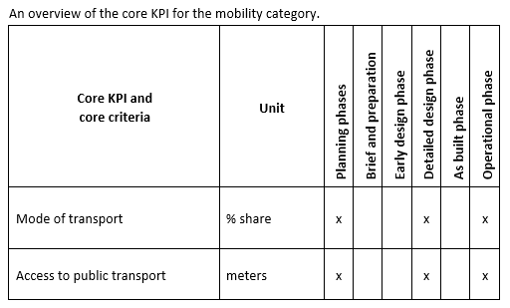

Slide 29
